Slide 1
Improving Speed Dating Using Analytics
Anil Kumar
July 12, 2021

Slide 2
Current Situation

Slide 3
Goal

Slide 4
Even Better

Slide 5
Data and Diagnostic Model

Slide 6
Overview
8,378 speed dating encounters
6,998 (83.5%) non-matches
~17 out of 20
1,380 (16.5%) matches
~3 out of 20

Slide 7
Features
Attractiveness, Intelligence, Sincerity, Funny, Ambition, and Shared Interests
Person’s rating of partner
Partner’s rating of person
Person’s self-rating
How important is the trait to person?
How important is the trait is to partner?
Socio-demographic
Gender
Age
Race
Are the person and partner the same race
Importance that partner is the same race
Importance that partner is the same religion
Interests
Sports, TV Sports, Exercise, Dining, Museums, Art, Hiking, Gaming, Clubbing, TV, Reading, Theater, Movies, Concerts, Music, Shopping, Yoga
Other
How happy does the person expect to be with the people that they meet?
How much does the person like their partner?
How likely does the person think it is that their partner likes them?
How many matches does the person expect to get?
Have the person and partner have met before?

Slide 8
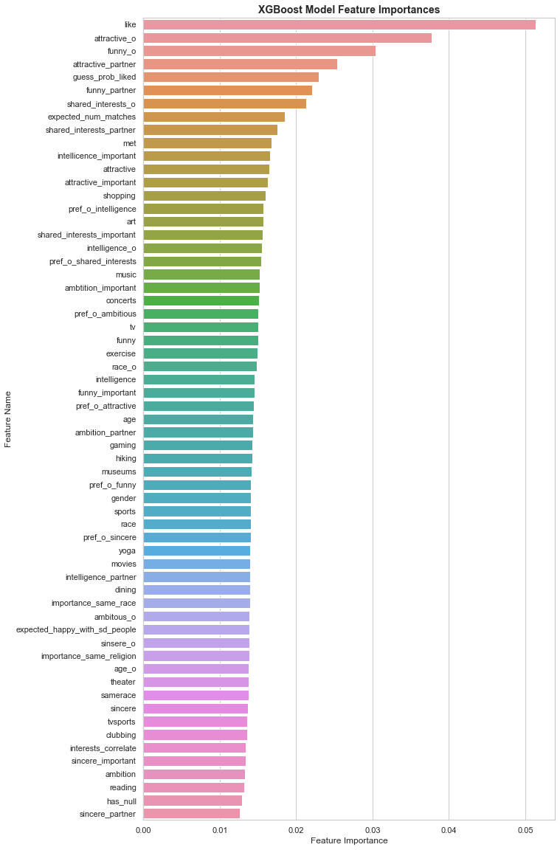
Most Predictive Features
Created a machine learning model that analyzed the feature impacts on predicting a match
Features with the most impact
Attractiveness
Funny
Liking each other
Shared Interests

Slide 9
Most Predictive Features
Created a machine learning model that analyzed the feature impacts on predicting a match
Features with the most impact
Attractiveness
Funny
Liking each other
Shared Interests

Slide 10
Match Rates Based on Shared Interest Ratings
 | Match Rate | % of Encounters
Both Rated 0-5 | 5.3% | 35.5%
One Rated 0-5, Other Rated 6-8 | 14.2% | 36.7%
One Rated 0-5, Other Rated 9-10 | 18.7% | 4.3%
Both Rated 6-8 | 32.1% | 16.8%
One Rated 6-8, One Rated 9-10 | 44.9% | 5.6%
Both Rated 9-10 | 60.0% | 1.2%

Slide 11
Match Rates Based on Shared Interest Ratings
 | Match Rate | % of Encounters
Both Rated 0-5 | 5.3% | 35.5%
One Rated 0-5, Other Rated 6-8 | 14.2% | 36.7%
One Rated 0-5, Other Rated 9-10 | 18.7% | 4.3%
Both Rated 6-8 | 32.1% | 16.8%
One Rated 6-8, One Rated 9-10 | 44.9% | 5.6%
Both Rated 9-10 | 60.0% | 1.2%
72.2%
of encounters

Slide 12

Diagnostic Model - Evaluation
Features
from
encounters
(ratings,
demographics,
interests,
etc.)
> THRESHOLD
Match
Predicted
Evaluate:
Compare
Predictions to Actual Outcomes
Diagnostic
Model
Probability of a Match
< THRESHOLD
Non-Match
Predicted

Slide 13
Hypothetical Threshold 10%
> 10%
Features
from
4
encounters
Probability of a Match
51%, 70%, 30%, 45%
4 Matches
Predicted
Diagnostic
Model
< 10%
0 Non-Matches
Predicted

Slide 14
Hypothetical Threshold 65%
> 65%
Features
from
4
encounters
Probability of a Match
51%, 70%, 30%, 45%
1 Match
Predicted
Diagnostic
Model
< 65%
3 Non-Matches
Predicted

Slide 15
Results from Diagnostic Model
 | Threshold 10% | Threshold 50% | Threshold 65%
% Encounters predicted as matches | 33.7% | 11.2% | 7.3%
% Match predictions that are correct | 41.2% | 64.9% | 74.8%
100 encounters
(expect 16-17 matches)
33-34 matches
predicted
11-12 matches
predicted
7-8 matches
predicted
13-14 matches correctly predicted
7-8 matches correctly predicted
5-6 matches correctly predicted
-Detect more matches
-Lower confidence in
the predictions
-Detect fewer matches
-Higher confidence in
the predictions
Trade-off

Slide 16
Future Directions

Slide 17
Create Pre-Event Survey
Use diagnostic model results to create a pre-event survey that collects data on the most predictive features
Shared Interests
Preferences for a partner
If repeat customer, use data from previous events
Appropriate length
Reduce data quality issues (i.e. missing or invalid entries)

Slide 18
Create Prediction Model
Create model to predict matches based on pre-event data
Arrange clients into events that give them the best chances at finding matches
Enhanced experiences
Referrals
Reviews
Reputation
Repeat customers

Slide 19
Longitudinal Data Collection
Clients that matched
Did matches last in long-term romantic relationships or friendships?
Clients that didn’t match
What were the issues?
What can we do to help them find matches?

Slide 20
Customer Lifetime Value
CLTV = Customer Value x Average Customer Lifespan
CLTV = $30/event x 1 event = $30
Over the course of 1,000 customers: $30,000
If 500 out of 1,000 customers elect to attend 2 events:
Average Customer Lifespan = 1.5 events
CLTV = $30/event x 1.5 events = $45
Over the course of 1,000 customers: $45,000

Slide 21
Summary
Data
Diagnostic
Model
Refine Data Collection
Increase
Value Creation & Value Capture
Data Driven Personalized Experience
Prediction Model

Slide 22
Questions?

